Slide 1
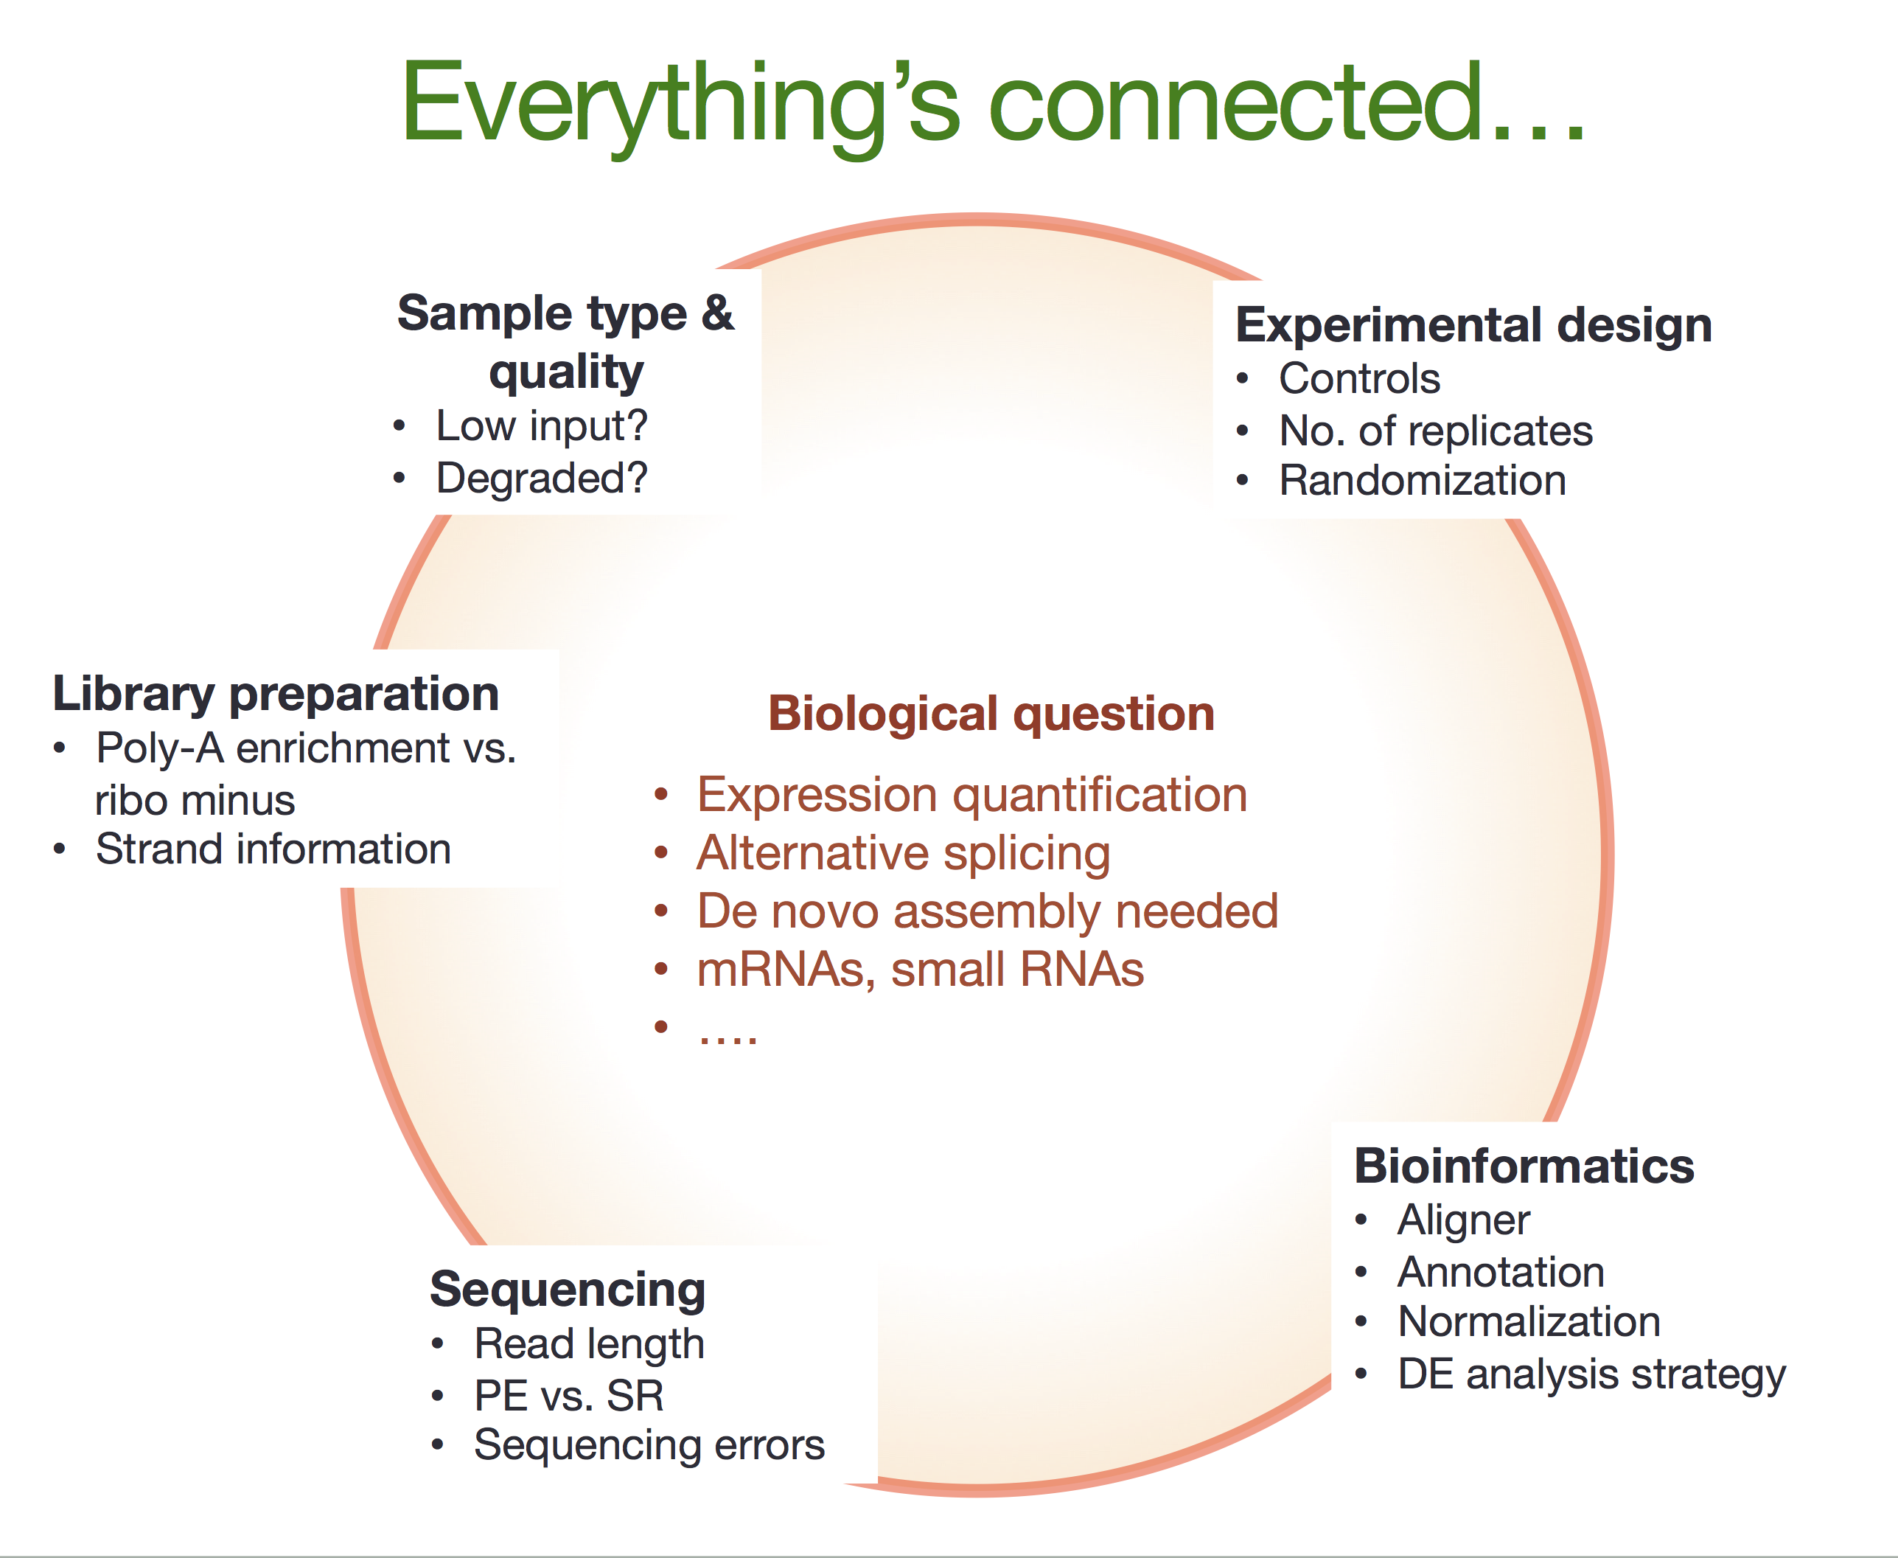
Lecture 1: Setting up an RNA-Seq experiment at UVM
Princess Rodriguez, PhD
MMG 232
Spring 2023

Slide 2
Learning Objectives
Understand how an RNA-Seq experiment is planned and considerations that should be taken by the experimenter

Slide 3
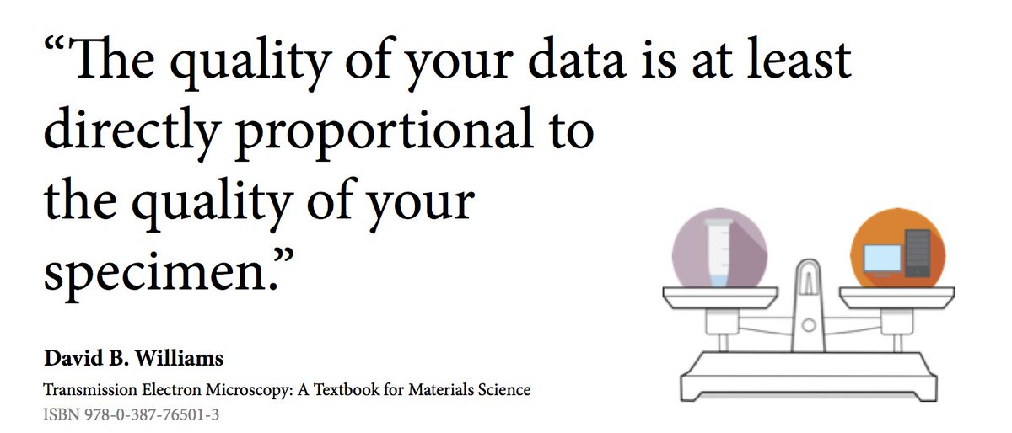
Why?

Slide 4
Caveat
Transcriptome is the collection of all transcript readouts present in a cell.
RNA-seq can be used to explore and/or quantify the transcriptome of an organism, which can be utilized for many different types of experiments:

Slide 5
Caveat
Differential Gene Expression: quantitative evaluation and comparison of transcript levels across treatments or groups
Transcriptome assembly: building the profile of transcribed regions of the genome
Meta-transcriptomics

Slide 6
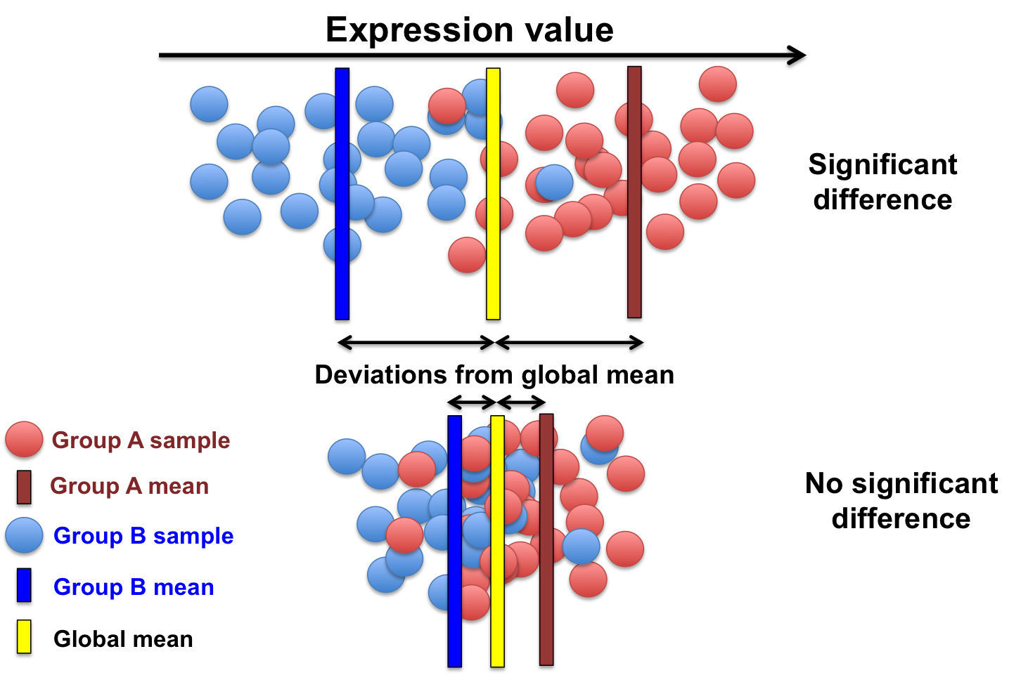
Basic types of questions answered:
What genes are differentially expressed between conditions?

Slide 7
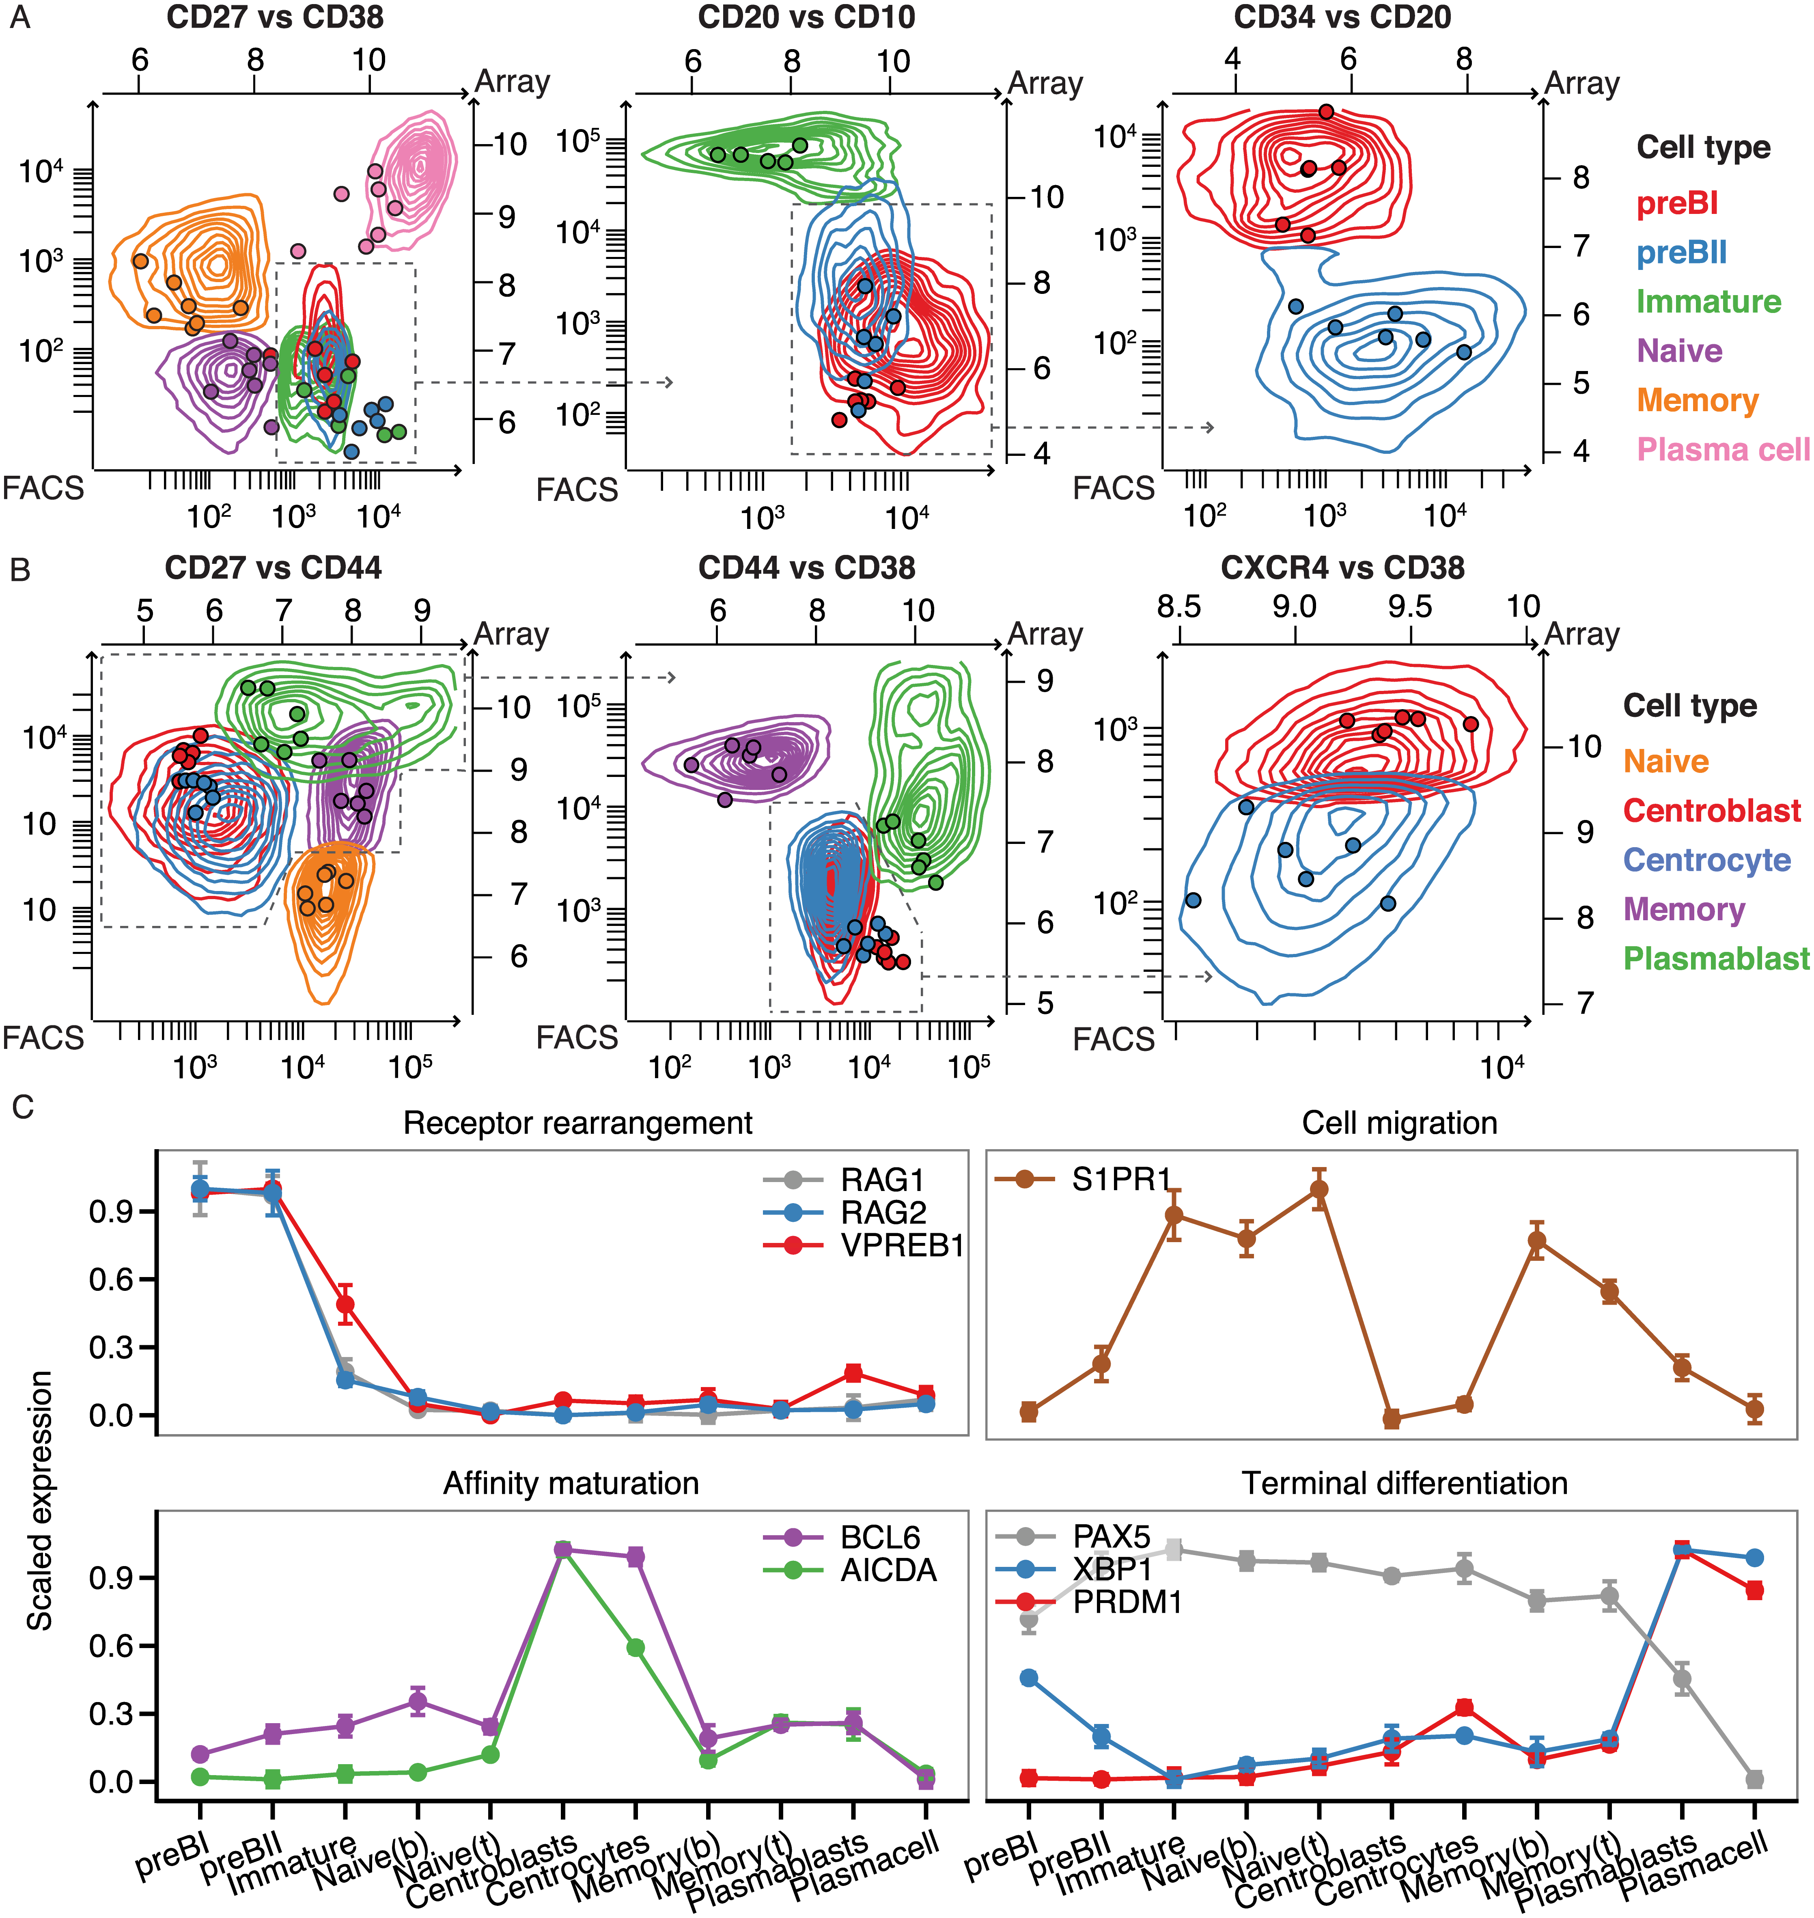
Basic types of questions answered:
Are there any trends in gene expression over time or across conditions?
Which groups of genes change similarly over time or across conditions?
https://journals.plos.org/plosone/article?id=10.1371/journal.pone.0138236

Slide 8
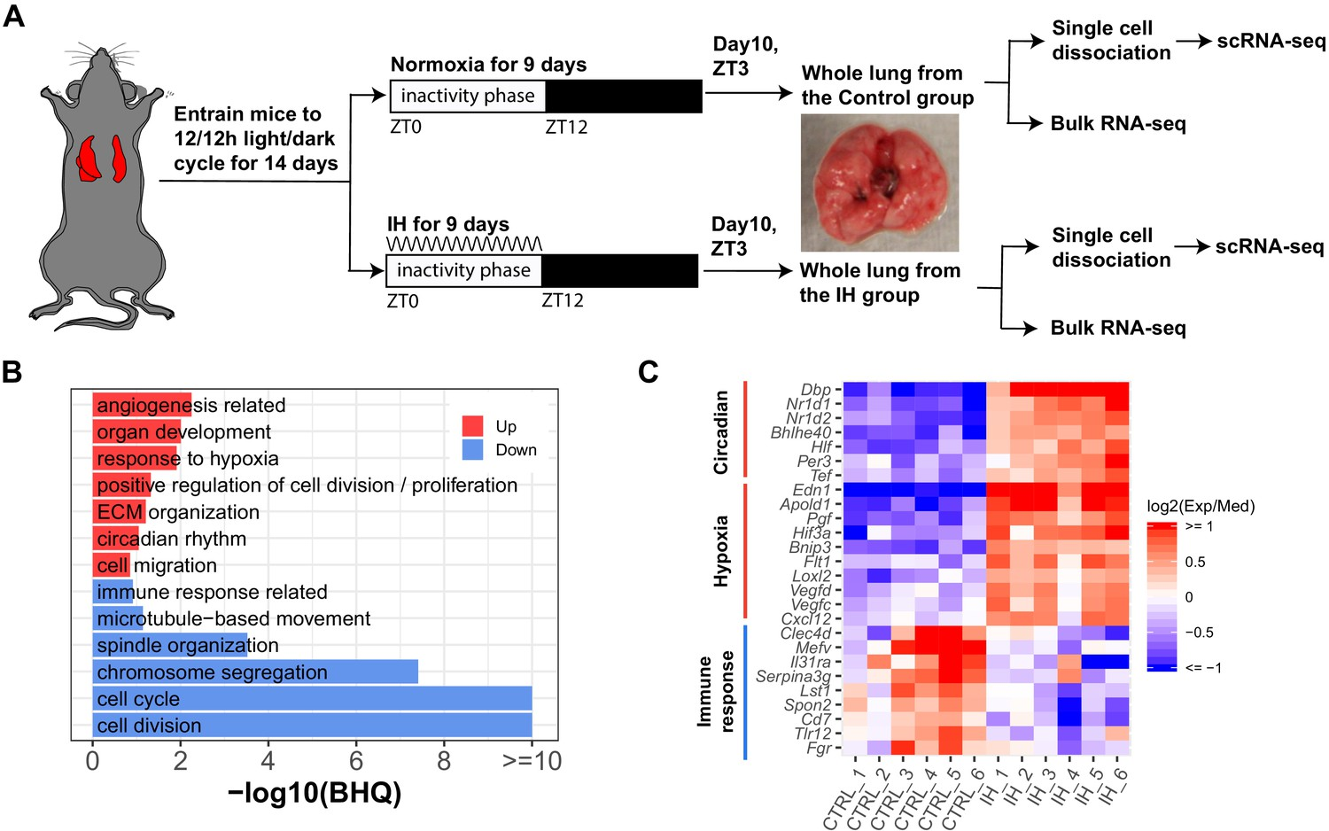
Basic types of questions answered:
What processes or pathways are important for my condition of interest?
https://elifesciences.org/articles/63003

Slide 9
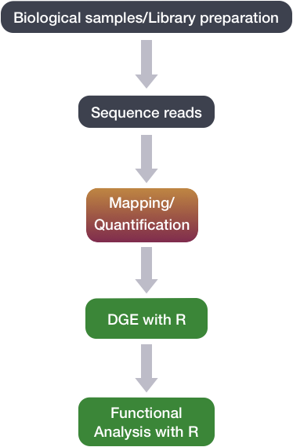
Step 1
Step 2
Step 3: Data Analysis

Slide 10
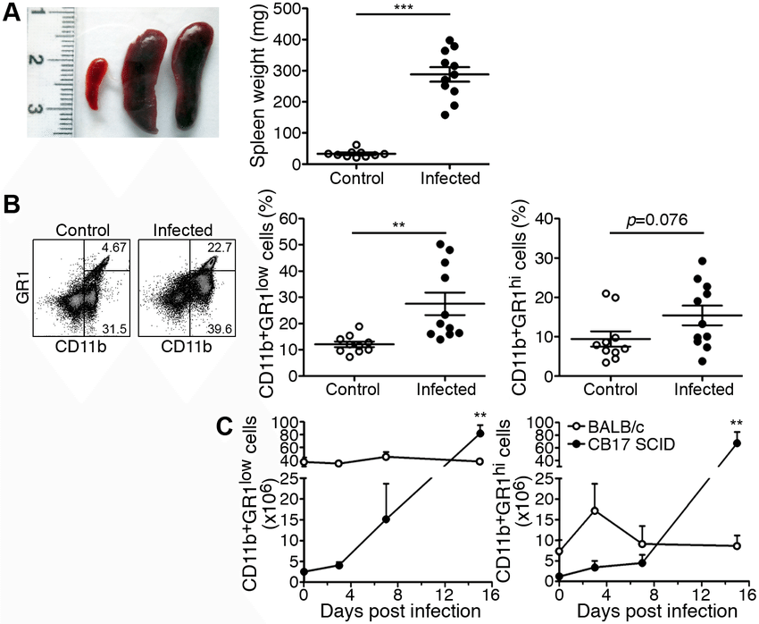
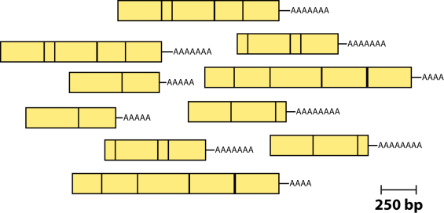
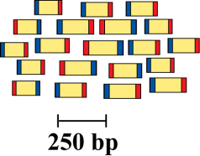
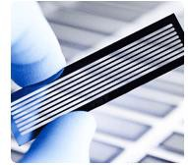
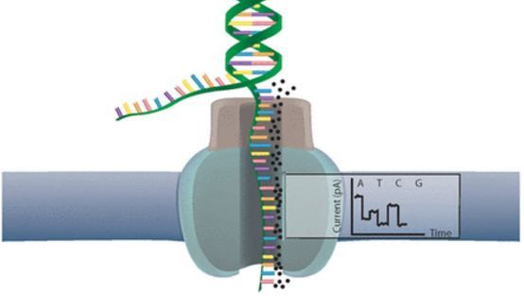
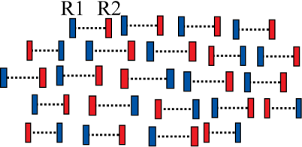

Experimental workflow
1
2
Isolate RNAs
Samples of interest
PMID: 27548618
3
Library build
5
Reads (R1 and R2) generated
Illumina sequencing
versus
ONP
4

Slide 11
Biological Replicates
To detect Differentially Expressed Genes (DEGs) between groups we should have several samples, which are also known as biological replicates
Condition 1
Condition 2

Slide 12
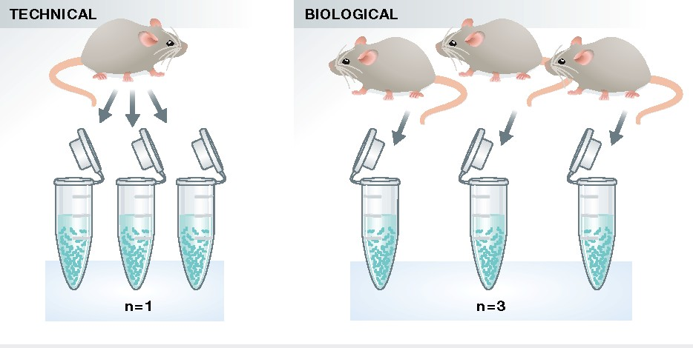
Biological Replicates
We are not talking about technical replicates
Assessing biological variation requires biological replicates
Three is the standard minimum
Yet I would recommend four or more
Notes:
biological replication is required if inference on the population is to be made, with three replicates being the minimum for any inferential analysis. For a proper statistical power analysis, estimates of the within-group variance and gene expression levels are required.

Slide 13
Probability of detecting DEGs
 | Replicates per group
 | 3 | 5 | 10
Fold change
2 | 87% | 98% | 100%
PMID: 26813401
Notes:
Probability of detecting DEGs

Slide 14
Grouping of Replicates
What you want
What you get

Slide 15
Grouping of Replicates
What you want
What you get
That spare comes in handy
Highly recommend especially with mice!

Slide 16
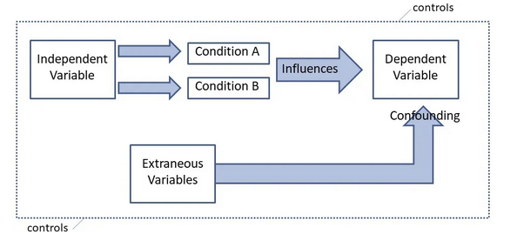
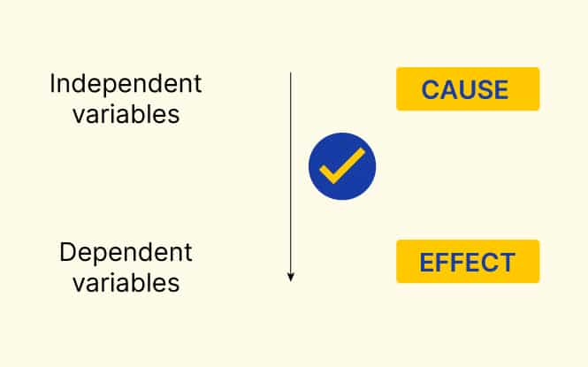
What causes this? Confounding variables
A variable that influences or confounds the relationship between an independent and dependent variable

Slide 17
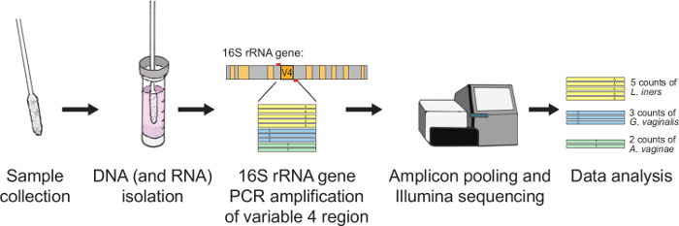
Examples of confounding variables
A new technician is running the sequencer

Slide 18
Examples of confounding variables
Extracting DNA/RNA with two different kits!

Slide 19
Examples of confounding variables
Sequencing on multiple different types of platforms

Slide 20
Examples of confounding variables
Inappropriate multiplexing strategy

Slide 21
What this means?
Its sometimes impossible for bioinformaticians to partition biological variation from technical variation, when these two sources of variation are confounded.
No amount of statistical sophistication can separate confounded factors after data have been collected.
…these confounding variables may or may not be in your control!
A well-planned experiment goes a long way

Slide 22
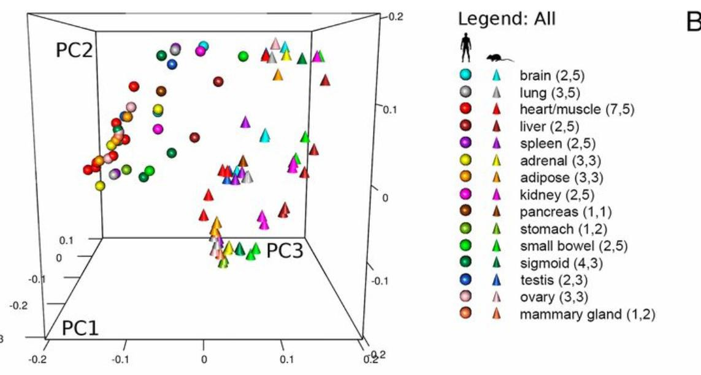
ENCODE reported that gene expression was likely to follow a species-specific rather tissue-specific pattern
https://doi.org/10.1073/pnas.1413624111
https://doi.org/10.1073/pnas.1413624111

Slide 23
ENCODE reported that gene expression was likely to follow a species-specific rather tissue-specific pattern
https://doi.org/10.1073/pnas.1413624111
https://doi.org/10.1073/pnas.1413624111

Slide 24
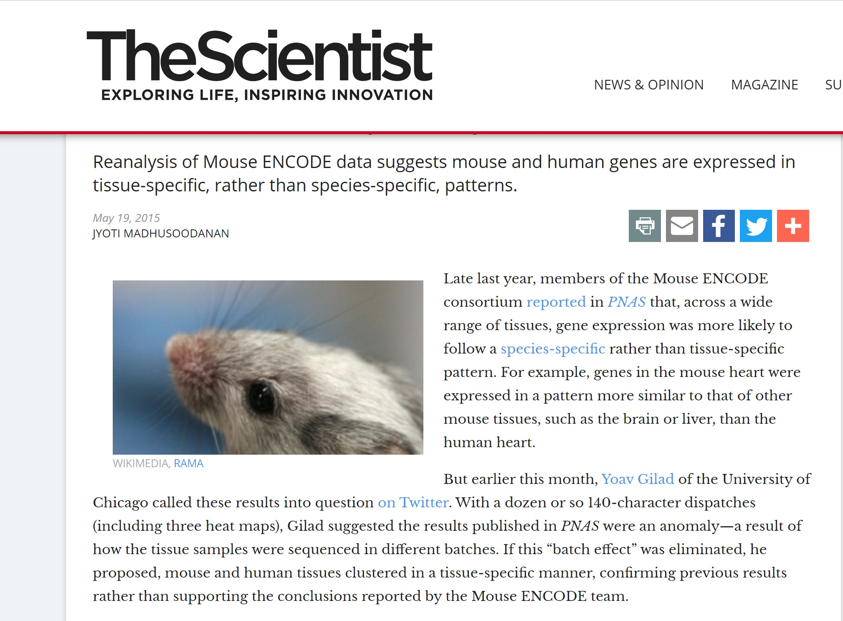

Slide 25
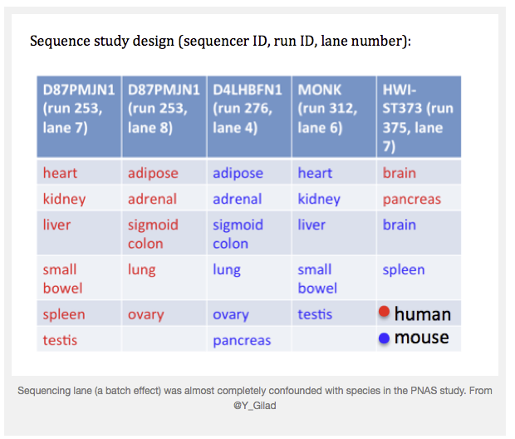

Slide 26
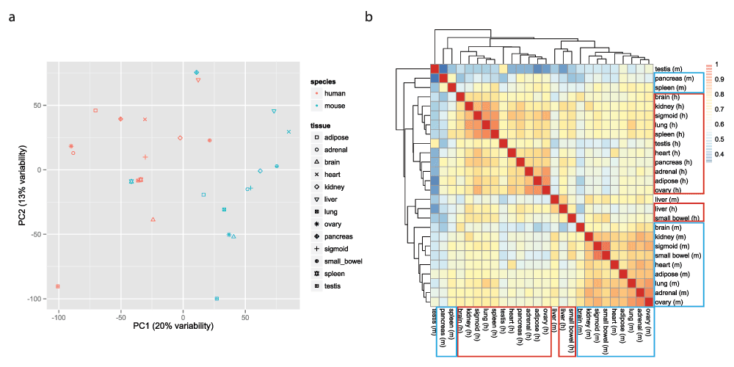
Before accounting for batch effect
Samples grouped by animal

Slide 27
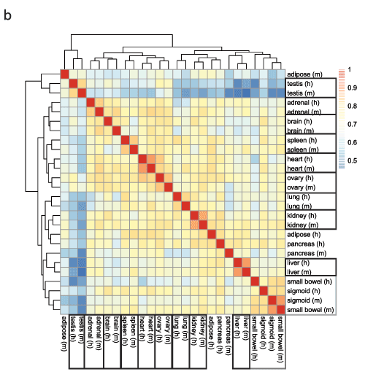
After accounting for batch effect
Samples now grouped by tissue

Slide 28
Experimental workflow
1
2
Isolate RNAs
Samples of interest
PMID: 27548618
3
Library build
5
Reads (R1 and R2) generated
Illumina sequencing
versus
ONP
4

Slide 29
Working with RNA
RNA-Seq is dependent on the isolation of pure RNA
RNA is more labile than DNA so extra precautions should be taken

Slide 30
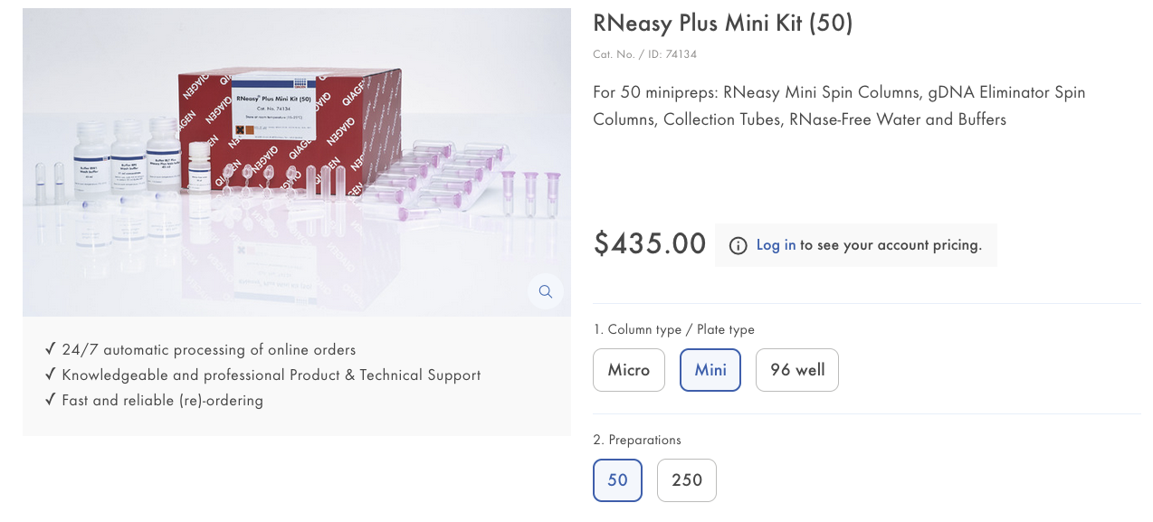
Isolation of RNA
This kit comes everything you need for total RNA isolation including the gDNA eliminator spin columns

Slide 31
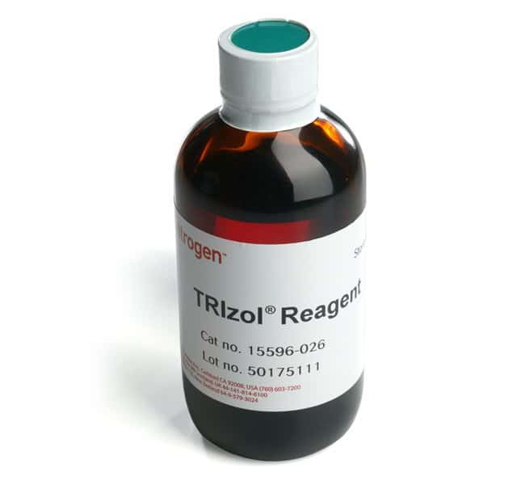
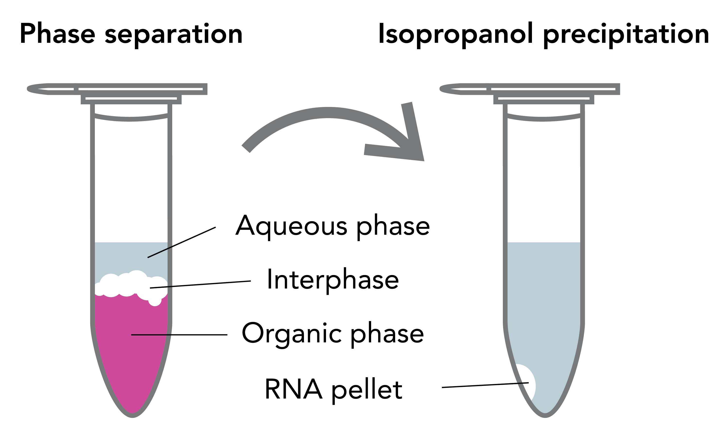
The cheaper way to isolate RNA
The UVM VIGR core does not recommend as residual phenol will inhibit the library build and you cannot get rid of it. They will not sequence your samples if you use this mode of isolation!

Slide 32
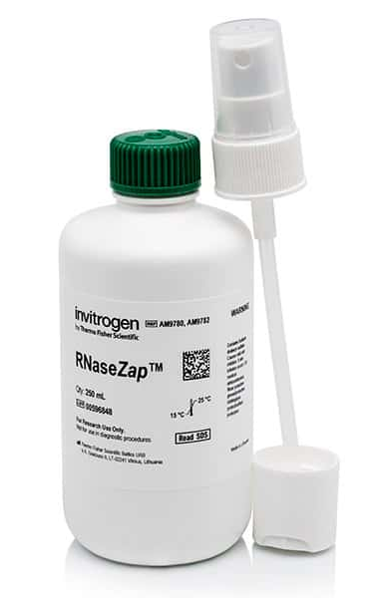
Other recommendations
Maintain RNA integrity with Ribolock (ThermoFisher: EO0381)
Once isolated, RNA is stored in the -80C

Slide 33
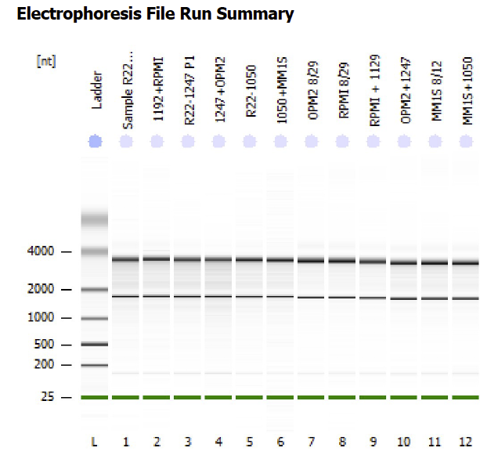
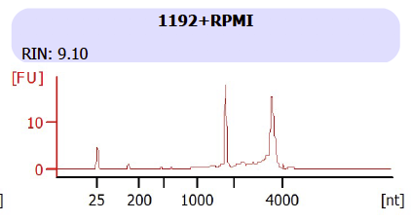
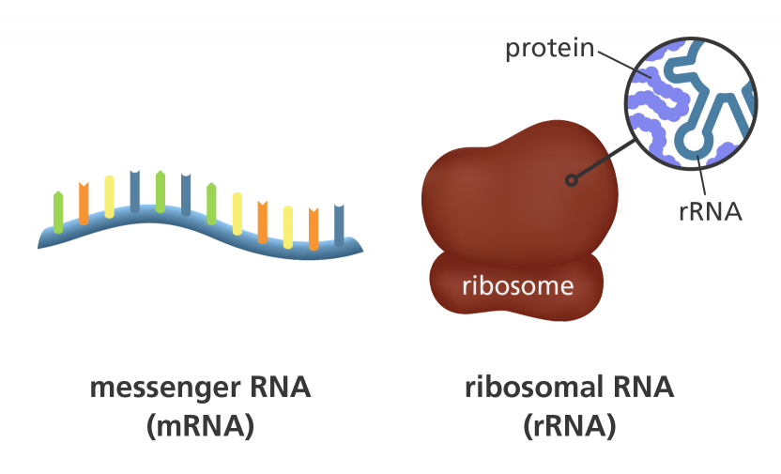
Check purity with RNA bioanalyzer

Slide 34
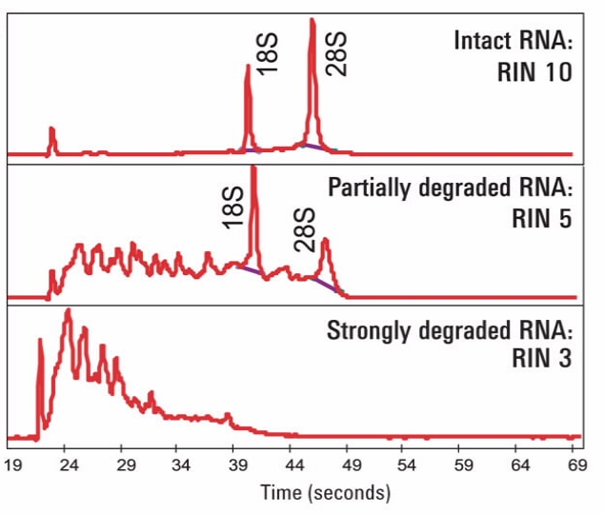

Slide 35
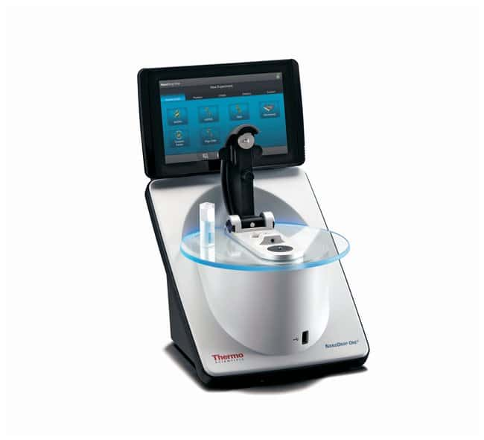
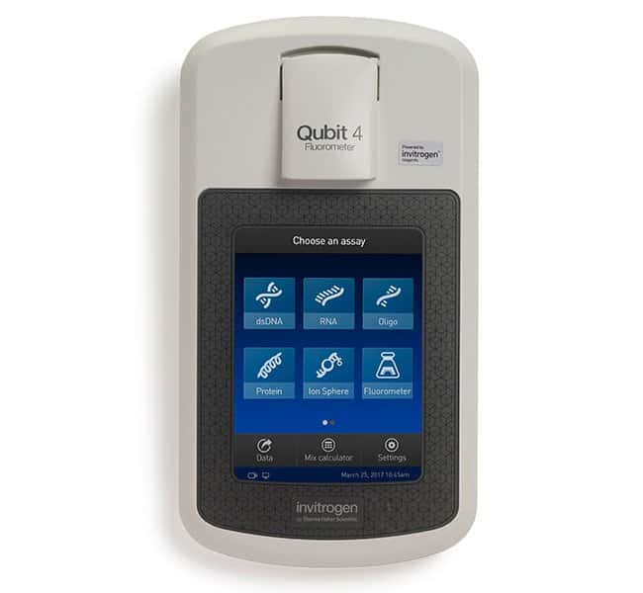
RNA Bioanalyzer requires Qubit
Need to take a Qubit reading not NanoDrop
NO!

Slide 36
Experimental workflow before it gets sequenced
1
2
Isolate RNAs
Samples of interest
PMID: 27548618
3
Library build
5
Reads (R1 and R2) generated
Illumina sequencing
versus
ONP
4

Slide 37
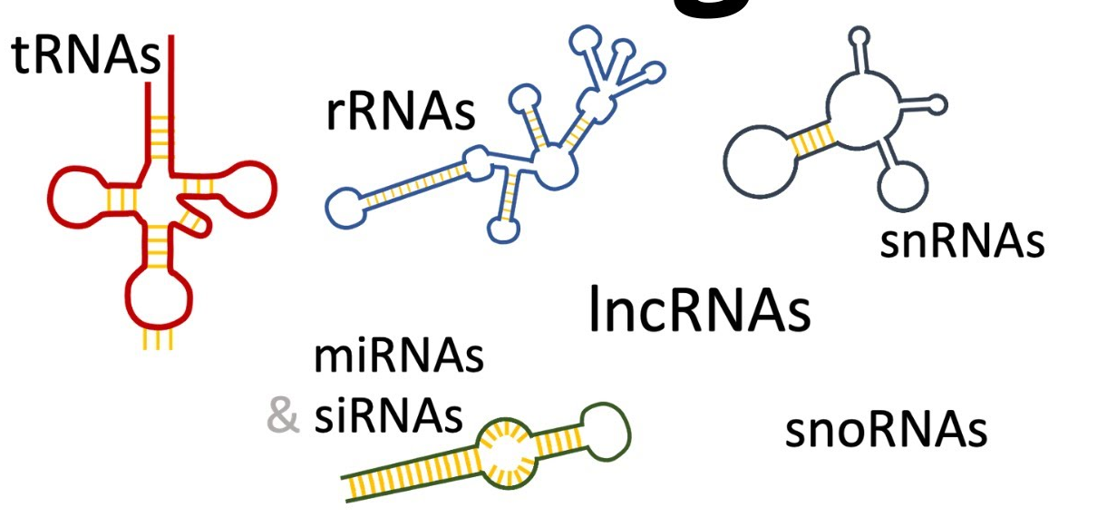
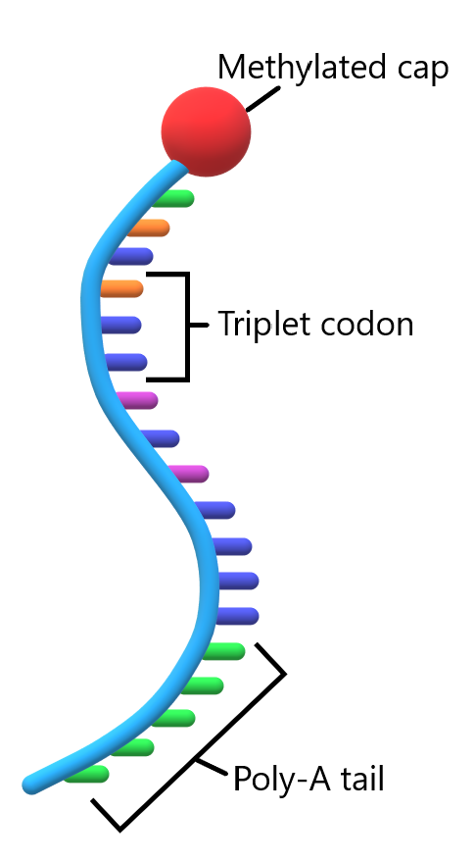
RNA composition
RNA comes in many different flavors
Ribosomal-related RNAs:
rRNA, tRNA, snoRNA (up to 90% of RNAs)
Protein-coding RNAs:
mRNA
Regulatory RNAs:
microRNAs, lncRNAs
messenger RNA
Kukurba, Mongomery (2015) Cold Spring Harb. Protoc. Gaida SM et al. (2015) Nat Comm 6:7045

Slide 38
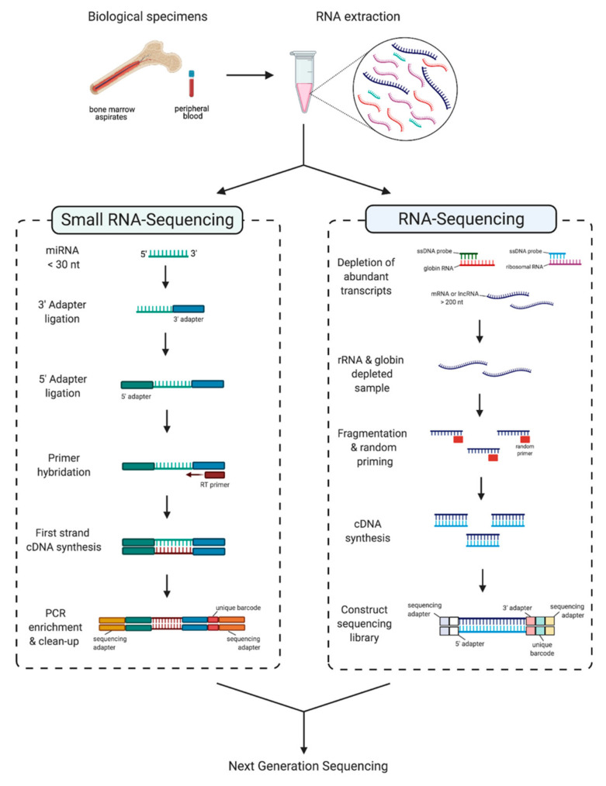
“Comprehensive” transcriptome analysis
Two different protocols/kits!

Slide 39
Before building the libraries need to perform target enrichment
If rRNA is not removed, the majority of the final sequencing reads would be from rRNA and not mRNA
Therefore, it necessary to enrich for mRNA
Two common strategies:
Poly A+ selection = mRNA only
rRNA depletion = mRNA + other species

Slide 40
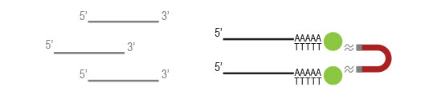
Poly-A versus rRNA depletion?
For differential gene expression, most enrich using Poly(A)+
However:
If you are aiming to obtain information about long non-coding RNA’s perform ribosomal RNA depletion
Bacterial mRNAs are also not poly-adenylated

Slide 41
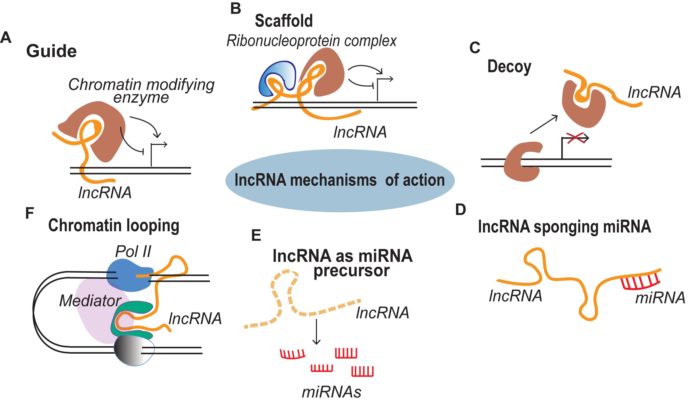

Slide 42
Strandedness
The implication of stranded libraries is that you could distinguish whether the reads are derived from forward or reverse-encoded transcripts
Another consideration is whether to generate strand-preserving libraries
Libraries can be stranded or unstranded

Slide 43
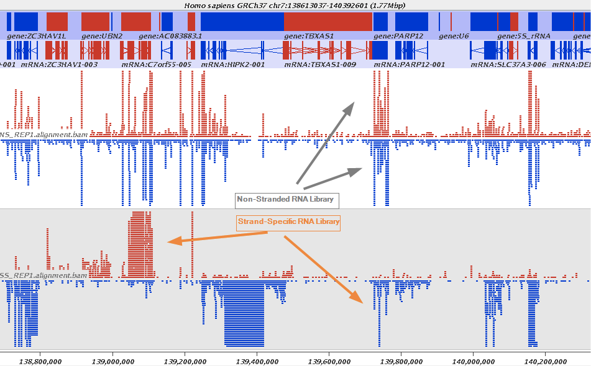
Strandedness
Red = + strand
Blue = - strand

Slide 44
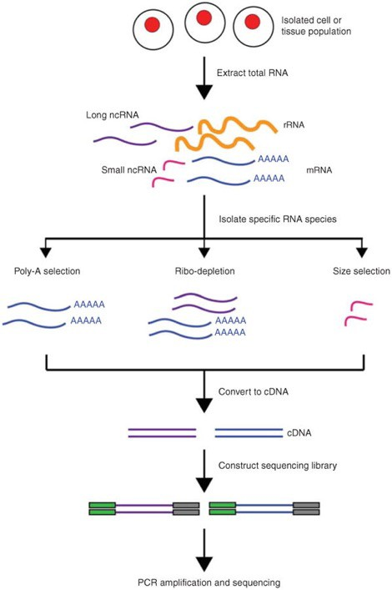

RNA-seq Library build steps
Isolate RNA
RNA species diversity
target enrichment
cDNA conversion /
PCR amplification
Kukurba, Mongomery (2015) Cold Spring Harb. Protoc. Gaida SM et al. (2015) Nat Comm 6:7045

Slide 45
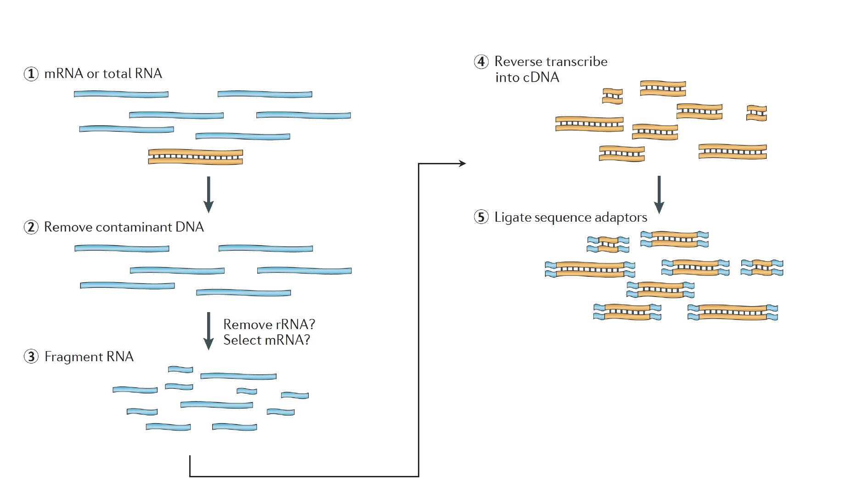
Library Prep steps

Slide 46
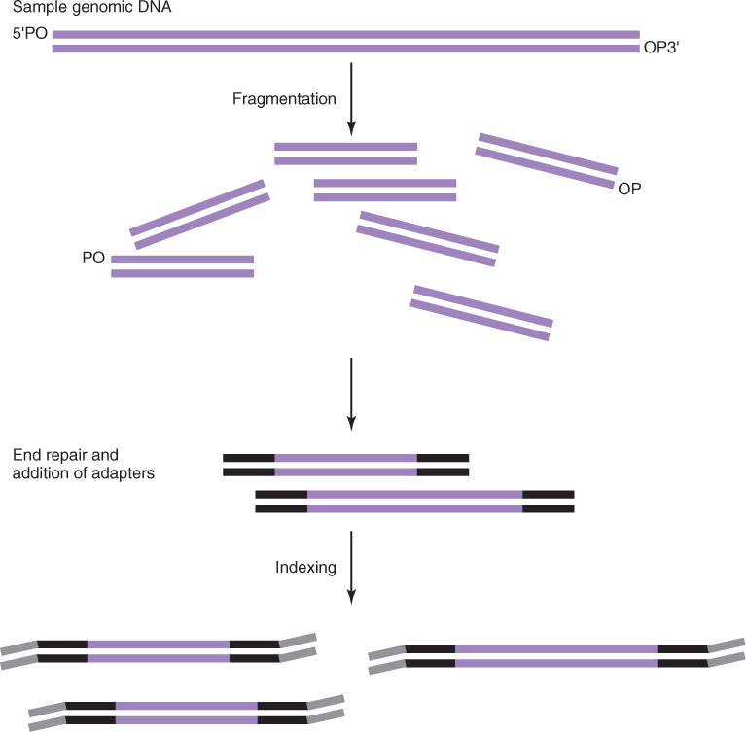
Adapters vs Index
Adaptors will serve as primer binding sites for amplification and sequencing, and for immobilization of fragments by hybridization
Indices can also be used as a “barcode”/sample ID to combine many samples into 1 seq. run

Slide 47
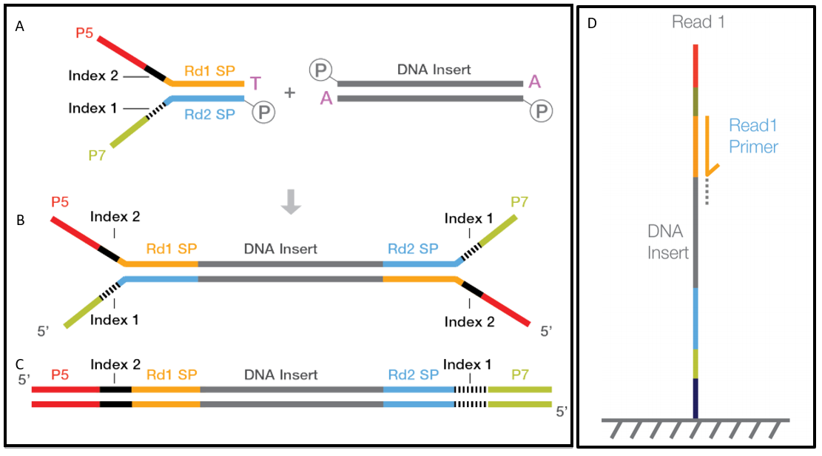
Architecture of Standard Illumina NGS library
P5 and p7 sequences are required to bind the flow cell
Adapter
Unique index

Slide 48
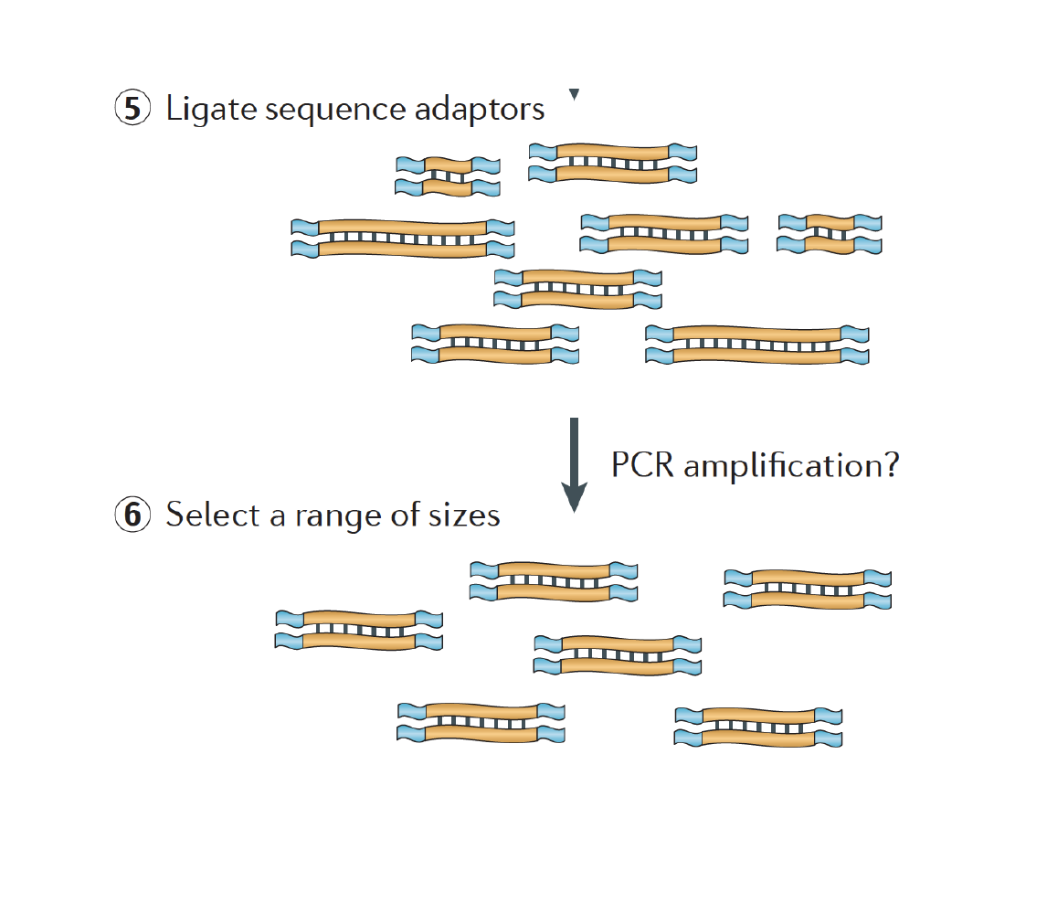
Library Prep steps continued

Slide 49
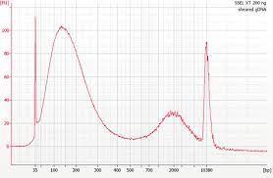
Common mistakes during library build
Addition of adapters and unique barcodes
Number of PCR cycles
Notes:
(temp, drying)

Slide 50
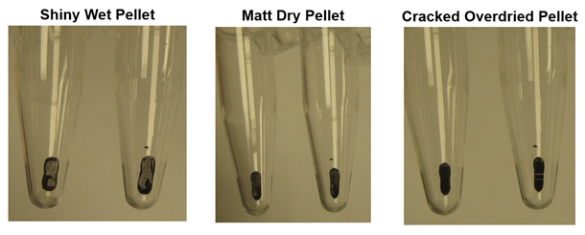
Common mistakes during library build
Addition of adapters and unique barcodes
Number of PCR cycles
Ampure XP beads usage
Notes:
(temp, drying)

Slide 51
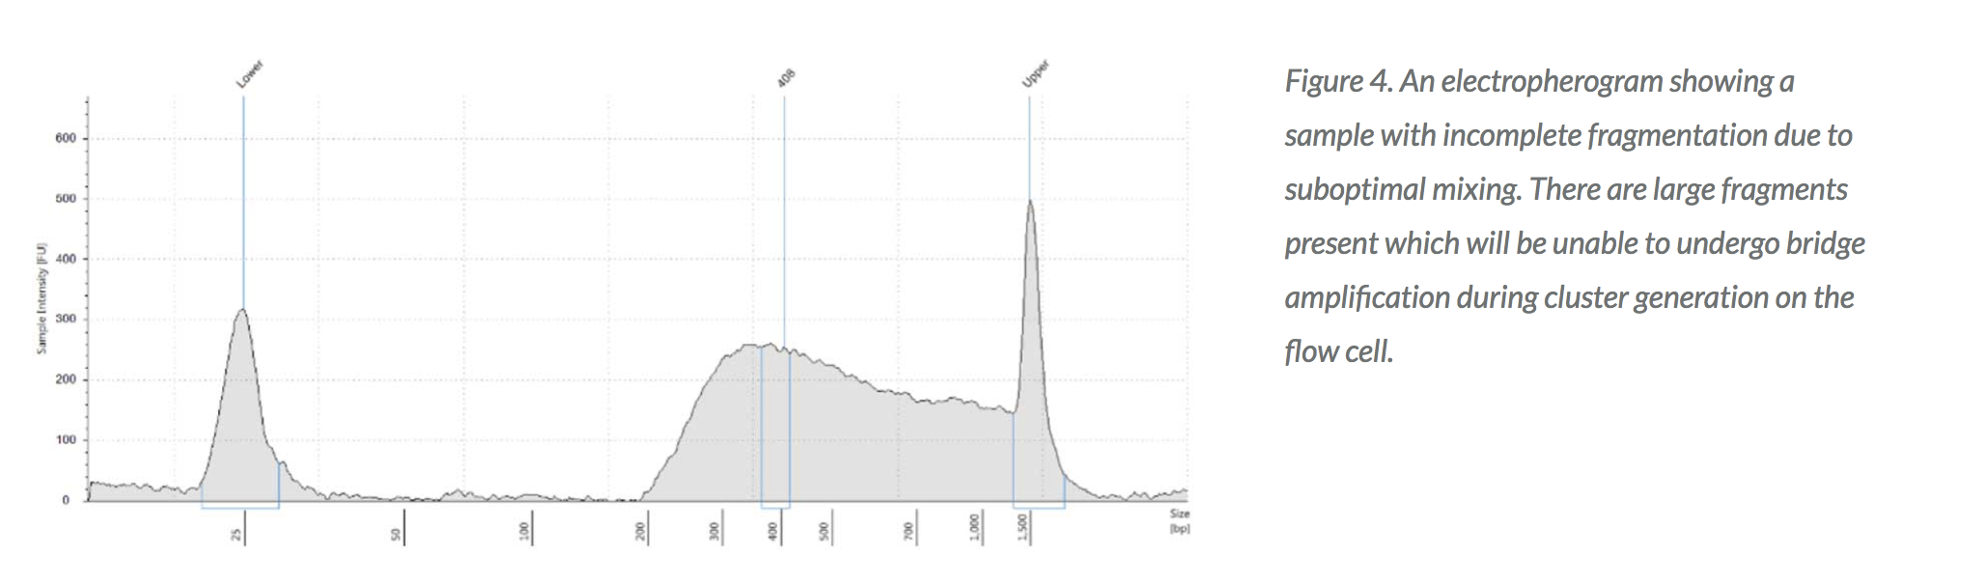
Common mistakes during library build
Addition of adapters and unique barcodes
Number of PCR cycles
Ampure XP beads usage
RNA fragmentation
Notes:
(temp, drying)

Slide 52
Experimental workflow before it gets sequenced
1
2
Isolate RNAs
Samples of interest
PMID: 27548618
3
Library build
5
Illumina sequencing
Reads (R1 and R2) generated
4

Slide 53
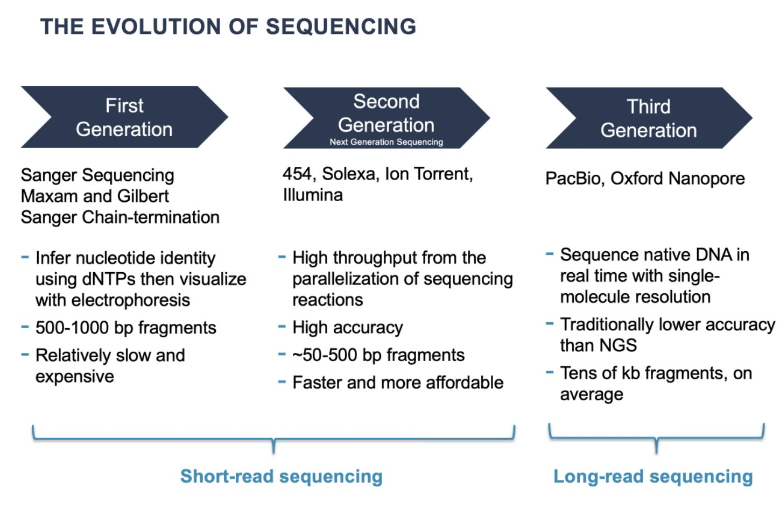
Two main approaches in NGS: short-read vs long-read

Slide 54
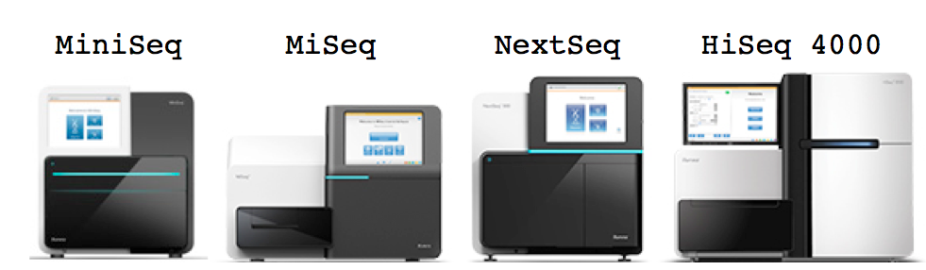
Second Generation Sequencing
Typical characteristics:
Reads are short (100-300bp)
Quality of bases decreases as the length of the read increases
Includes HiSeq, NextSeq, NovaSeq platforms
Run Time varies but can be up to > 48hrs
Maximum Output is ~25 to 400 million reads per lane

Slide 55
Sequencing Options
Illumina Sequencing options:
Length of sequence (up to 300 bases)
Paired-end (PE) or single-end (SE)
DNA FRAGMENT
PE | 50
PE | 100
SE | 50
SE | 100

Slide 56
Single-end vs paired-end
Single-end
cDNA
Fragment
Paired-end
What you get from VIGR:
Single-end: ONE fastq file per sample
Paired-end: TWO fastq files per sample

Slide 57
What is the Advantage of Longer and PE Reads?
Reads mapping to junctions
With longer reads we will have more reads spanning exons
Isoforms or distinguishing paralogs
Paired end reads
Knowing both ends of a fragment and an approximation of fragment size helps to determine the transcript from which it was derived.

Slide 58
When does SE vs PE matter?
If your considering studying:
long non-coding RNAs
De novo transcriptome assembly
Alternative splicing
Alternative RNA splicing is a process during gene expression that allows a single gene to produce many transcripts

Slide 59
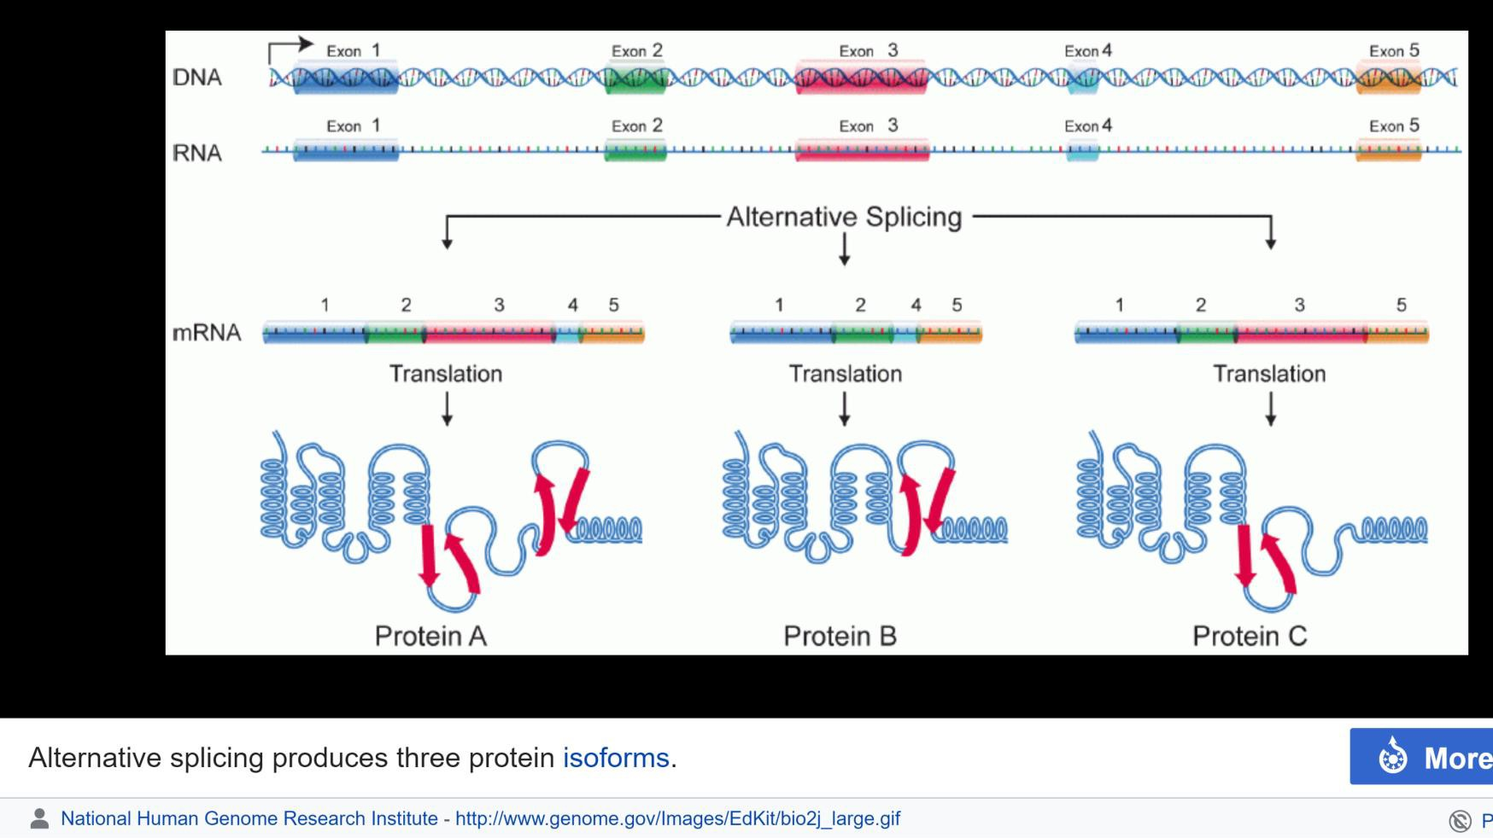
Alternative Splicing
Alternative splicing increases the biodiversity of proteins that can be encoded by the genome.
In humans, ~95% of multi-exonic genes are alternatively spliced
Alternatively spliced exons yield three different protein isoforms
5 of 45

Slide 60
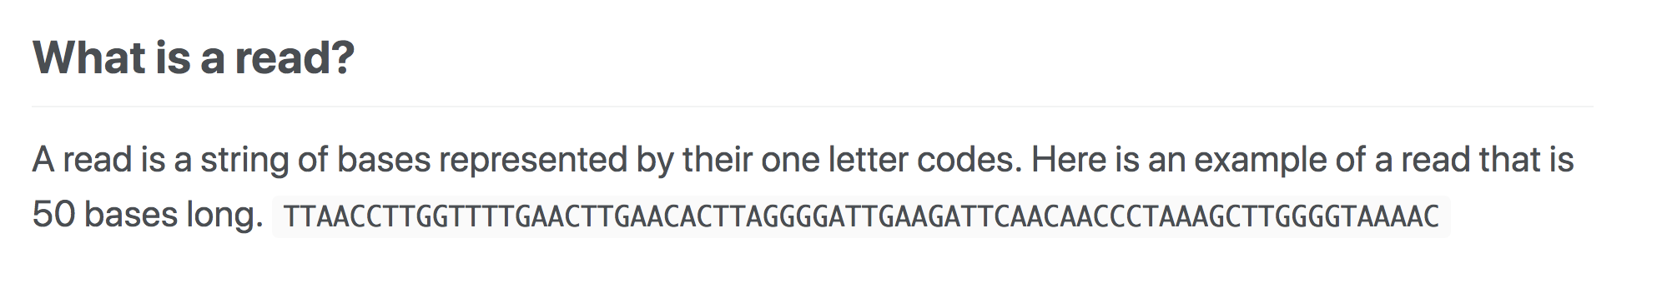
Other NGS terms

Slide 61
Other NGS terms
Read: A raw sequence that comes from a sequencing machine.
Sequencing depth: total number of sequences, reads, or bp generated in a single experiment

Slide 62
 | Replicates per group
 | 3 | 5 | 10
Fold change
2 | 87% | 98% | 100%
Sequencing depth (millions of reads)
3 | 19% | 29% | 52%
10 | 33% | 51% | 80%
15 | 38% | 57% | 85%
PMID: 26813401
Notes:
Probability of detecting DEGs

Slide 63
Other NGS terms
Read: A raw sequence that comes from a sequencing machine.
Sequencing depth: total number of sequences, reads, or bp generated in a single experiment
Coverage: Total number of bases generated per size of the genome sequences
What does it mean if someone says they want 15X coverage?

Slide 64




NGS Sequencing Terminology
Sequence Coverage
Insert Size
length
6X
0 1 2 3 4 5 6 7 8 9 10 11 12
0
200 400
insert size
600
Base coverage by sequence

Slide 65
In Summary, to quantify Differential Gene Expression
Read length: 50 to 100 bp
Paired vs single end: Single end (cheaper)
Number of reads: > 15 million per sample
Replicates: 3 biological replicates minimum
A well-planned experiment goes a long way!

Slide 66
What you want to do versus what you can afford
Service | Cost
RNA bioanalyzer | ~$60 for 12 samples
Qubit quant | ~$4 per sample
DNA bioanalyzer | ~$82 for 11 samples
Library build (if core does it) | ~$2800 for 12 samples
Library kit (if you do it) | ~$1600 for 12 samples
Sequencing | ~$2000 per lane
Total | ~$4900 OR $3700

Slide 67
Time breakdown
Service | Time
RNA isolation | Time to collect samples (days to months) + two days
Library build (if core does it) | Can take up to a month
Library build (if you do it) | One week
Sequencing (HiSeq) | Can take up to a month

